Slide 1
Ensemble Learning

Slide 2
Flow of the session
Clearing Out a very important prerequisite – Decision Trees
Intuition behind Ensemble learning and the different methods:
Bagging
Boosting
Blending
Stacking
Working of Popular Algorithms like Adaboost, Random Forests, Xgboost, etc and their use cases

Slide 3
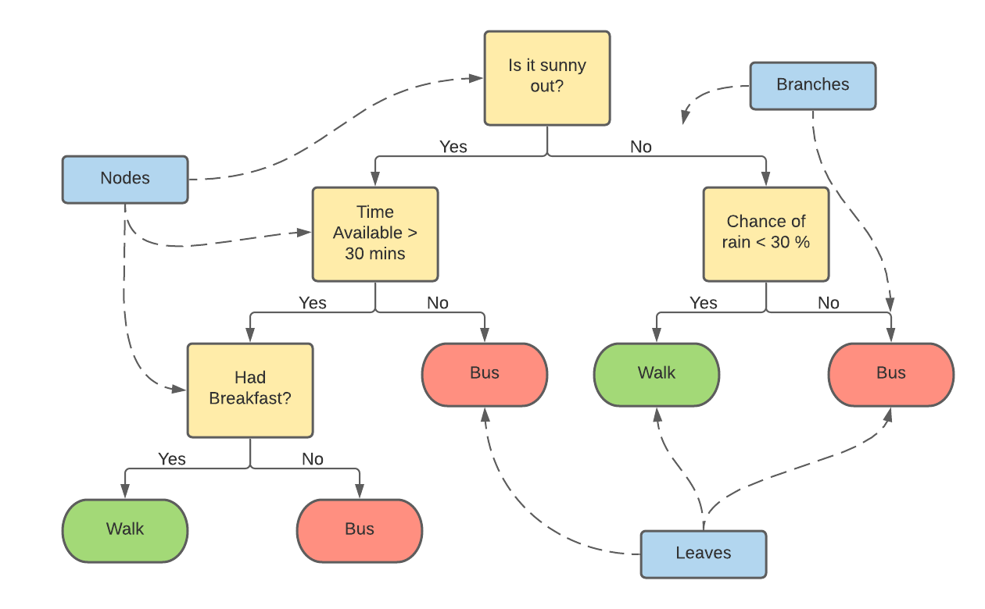
What are Decision Trees?
Flowchart based tree like structure. Internal nodes are test on certain attributes, the branches denote the output of the test and the leaf node (terminal nodes) are the output classes/labels

Slide 4


Evaluating the splits
These trees are formed by recursive “Splitting of data” into subsets based on their attributes.
How are these splits formed and how do we know if they are optimal?
Impurity
Measure of difference in the samples of the nodes.
Entropy is the amount of information needed to accurately describe a node.
Entropy is high if the samples are dissimilar or random.
Gini measures the inequality. While entropy is computationally more expensive, it gives slightly better results.

Slide 5
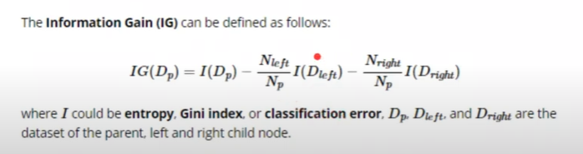
Information Gain
A less impure node requires less information to describe it. So we need to form splits minimizing the impurity. For this we have Information Gain
Aim here is to improve the cut criteria and create an optimal Decision splits
Example on notebook:

Slide 6
Piecing it Together
In case of a numeric variable,
Get all the unique values
Calculate information gain of each
Take the highest and its split condition
For a categorical value
Get all the combinations of that variable
Calculate information gain of each
Take the highest and its split condition

Slide 7
Hyper Parameters – Avoid Overfitting
Minimum samples needed to create a split
Minimum Information gain for a tree to still grow
Max Depth of the tree

